Slide 1
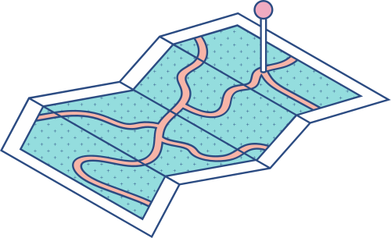

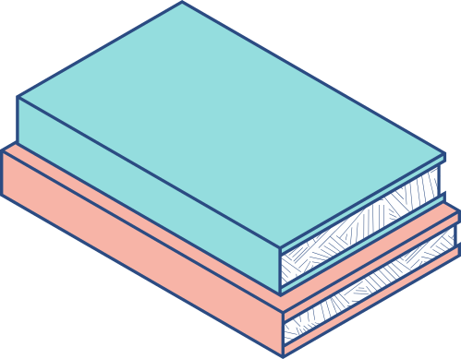




Cypress Viewport
Testing Your Responsive Designs

Slide 2
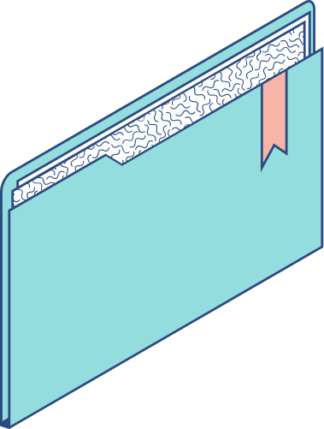
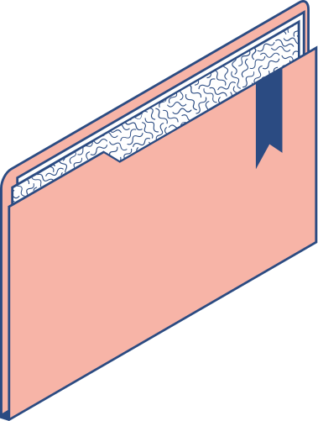
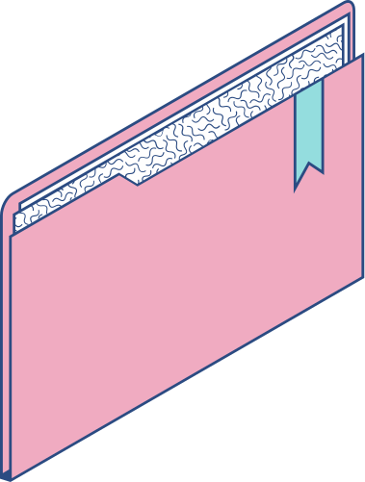
Agenda
What are viewports? Are there tools you can use? How can Cypress help? Screen Sizes Presents( Devices) Orientation Configurations Tips Testing on the LambdaTest Cloud

Slide 3
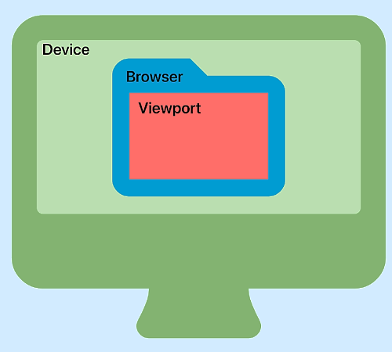
What are viewports?
A viewport refers to the visible area of a web page that is displayed within the browser window.
Why should we test for viewports?
User Experience
Responsive Design
Scroll Experience

Slide 4
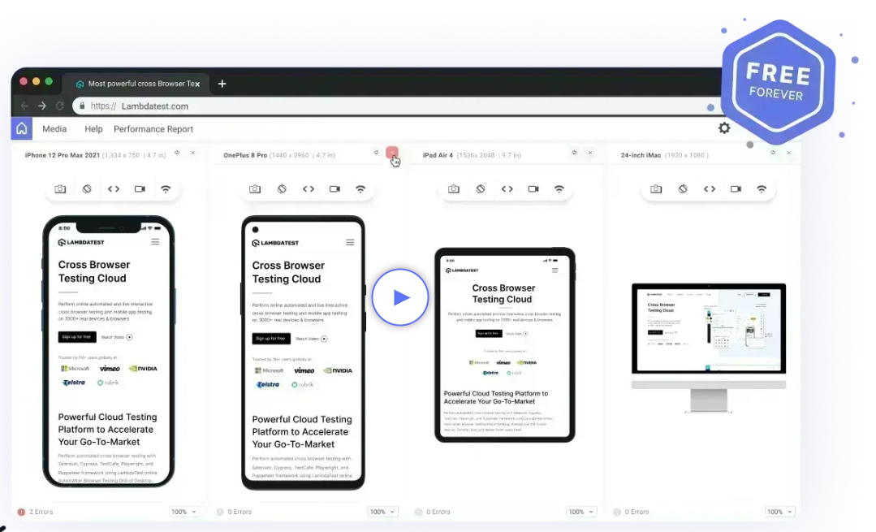
Tools
Manual tools
Take time
Hard to see bugs

Slide 5


Can Cypress help?
In Cypress, it is very easy to test on different viewports and verify how your website behaves across different screen sizes by specifying the desired dimensions.

Slide 6
How to start?
Node IDE Pacience

Slide 7
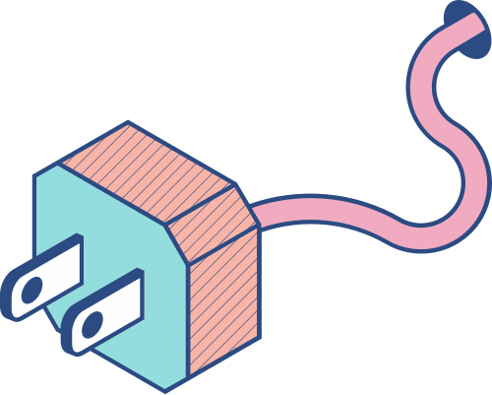

cy.viewport()
You can simulate different viewports in Cypress using the cy.viewport() command.
By specifying the width and height parameters, you can test how your website responds to various screen sizes.
You can simulate different viewports in Cypress using the cy.viewport() command.
By specifying the width and height parameters, you can test how your website responds to various screen sizes.

Slide 8


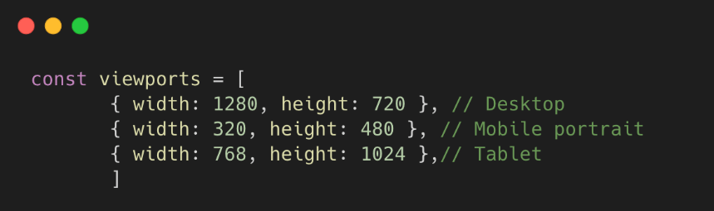
Testing multiple screens
You can simulate different viewports in Cypress using the cy.viewport() command.
By specifying the width and height parameters, you can test how your website responds to various screen sizes.

Slide 9
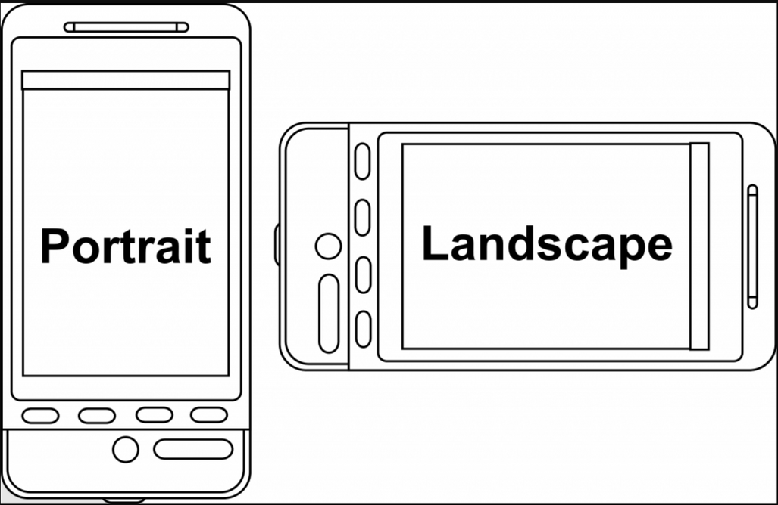
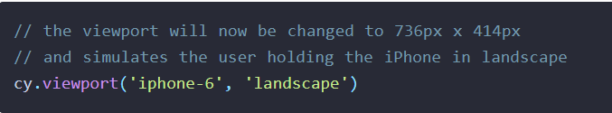
Check device orientation

Slide 10

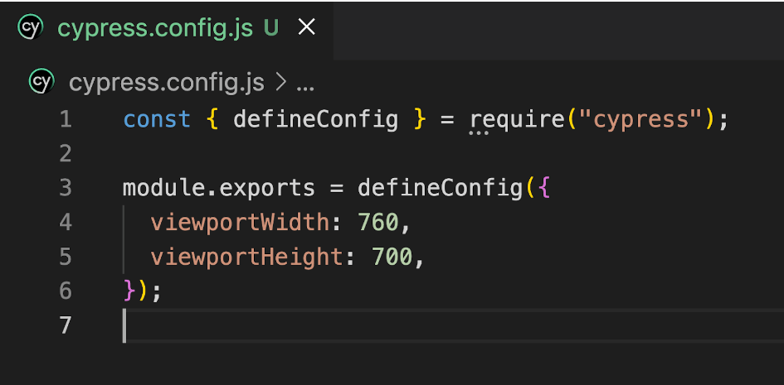
Configuration
Configuring viewport at the project level

Slide 11
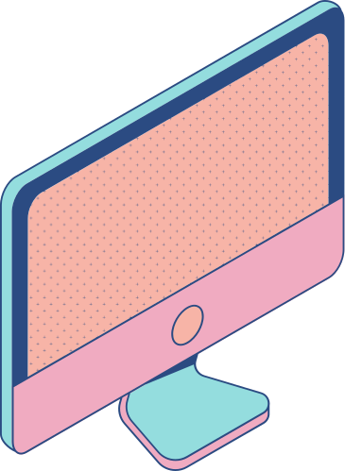

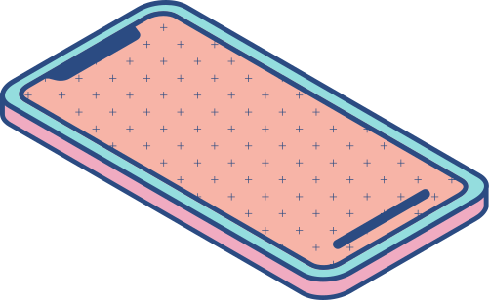
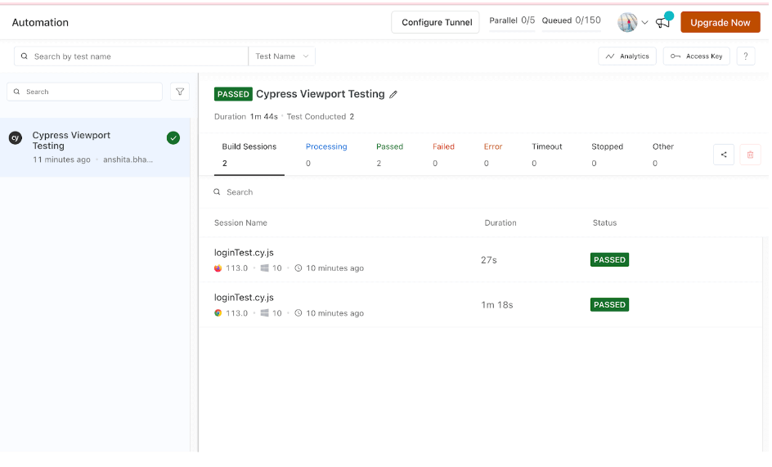
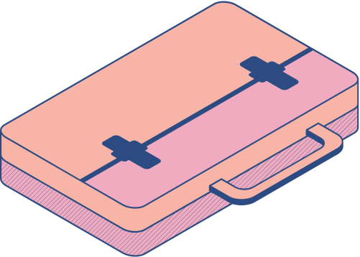
LambdaTest Cloud
What do we need?
Account
CLI
Config
Run

Slide 12

Next Steps
LambdaTest Blogs
https://www.lambdatest.com/blog/
LambdaTest YouTube
https://www.youtube.com/c/lambdatest
LambdaTest Certificates
https://www.lambdatest.com/certifications/

